Slide 1

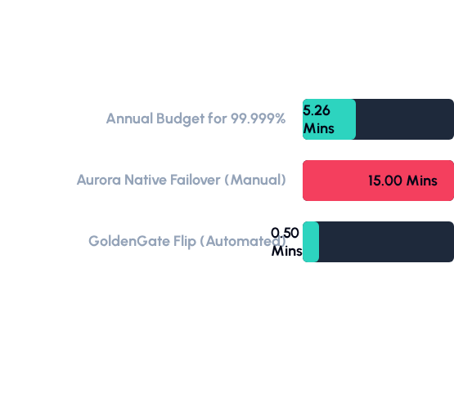

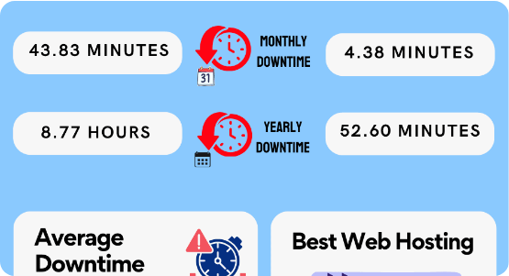

THE MATH OF FIVE 9S AVAILABILITY
Achieving 99.999% uptime permits only 5.26 minutes of downtime per year. Manual regional failover is mathematically incompatible with this goal.
•
Manual recovery requires DNS propagation and volume mounting.
Architectural Verdict:
•
Automated affinity routing bypasses regional cold-starts.
•
GoldenGate hubs maintain state during regional isolation.
A single manual Aurora failover consumes 285% of your annual budget. Active-Active is the only viable path to Five 9s.

Slide 2



ARCHITECTURE COMPARISON
Active-Passive (Native)
Active-Active (GoldenGate)
Primary-centric: Only one region can accept writes. Disaster recovery is a "Cold Promotion" event.
Affinity-based: Multi-region writers partitioned by program_id. Disaster recovery is a "Routing Flip."
•
RTO: 10-15 Minutes (Manual heavy).
•
RTO: < 30 Seconds (Fully Automated).
•
Write Availability: Binary. If Primary is down, writes stop globally.
•
Write Availability: Regional. Survivor region absorbs load instantly.
•
Scalability: Limited to Read Replicas only.
•
Scalability: Distributed write throughput across regions.
•
Complexity: High operational stress during outages.
•
Complexity: Zero-touch failover/failback cycle.
Strategic Choice:
By moving to Active-Active via GoldenGate, we decouple regional survival from storage replication. We gain the ability to perform rolling upgrades and instant failovers without cross-region dependency.

Slide 3


IMAGE SOURCES
https://cdn.kripeshadwani.com/wp-content/uploads/2025/04/uptime-calculator-infographic.png
Source: kripeshadwani.com
https://d8it4huxumps7.cloudfront.net/uploads/images/65646d0fdb931_cloud_computing_architecture_artboard_4.jpg?d=2000x2000
Source: unstop.com

